Slide 1
USDA FoodData Central (FDC)
Melissa Nickle, MPH
Beltsville Human Nutrition Research Center (BHNRC)
USDA, Agricultural Research Service
University of Maryland Graduate
Notes:
Good Morning and Welcome to the 2024 Info Challenge! It is an honor and a privilege to present my dataset to you today. My name is Melissa Nickle and I am a proud University of Maryland alumni and it is wonderful to be back on campus again. I am here today to present a data set from USDA’s FoodData Central. FoodData Central is part of the Beltsville Human Nutrition Research Center which is under the Agrigultral Research Service department of the USDA. We are located just north on Route 1 in Beltsville, Maryland. My background is in nutrition and public health so look forward to providing this food composition dataset in hopes of having data experts analyze the data in a creative and novel way.
Just to give you a little bit of background…

Slide 2
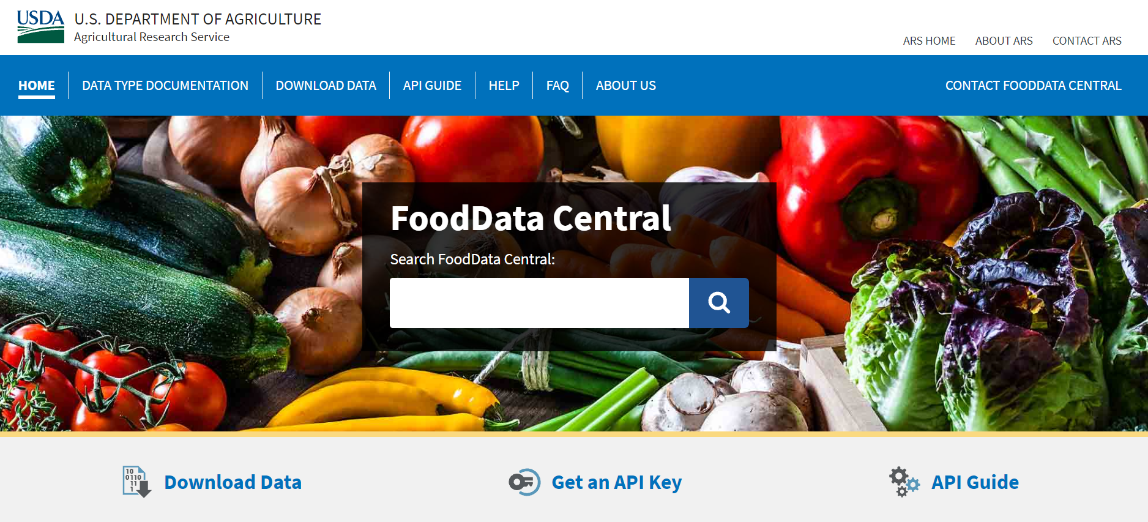


FoodData Central
FoodData Central is an integrated data system that provides expanded nutrient profile data and links to related agricultural and experimental research. fdc.nal.usda.gov
Notes:
FoodData Central is an integrated data system that provides expanded nutrient profile data and links to related agricultural and experimental research. The data can be accessed at the website fdc.nal.usda.gov
There are additional datasets available on our website if you are interested in downloading additional data. Branded Foods data set has over 450,000 entries if you are interested in a large dataset.
The data is available for download in 2 formats, either JSON or csv.
And we also offer an API for anyone interested in that as well.

Slide 3
Foundation Foods - Data and metadata on individual samples of commodity or commodity-derived minimally processed foods with insights into variability
Standard Reference (SR) Legacy - Historic data on food components including nutrients derived from analyses, calculations, and published literature
Food and Nutrient Database for Dietary Studies (FNDDS) - Data on nutrients and portion weights for foods and beverages reported in What We Eat in America, NHANES
Branded Foods - Data from labels of national and international branded foods collected by a public-private partnership
Experimental Foods - Data on food published in peer-reviewed journals supported by or in collaboration with USDA
Analytical
Analytical, calculated,
and imputed
Generic food profiles
Label data
Research
Notes:
FoodData Central currently houses 5 distinct datatypes in an effort to consolidate USDA’s Food composition data in one place. Each of these data types was developed to meet specific needs and has unique characteristics.
Foundation Foods - Data and metadata on individual samples of commodity or commodity-derived minimally processed foods with insights into variability
Standard Reference (SR) Legacy - Historic data on food components including nutrients derived from analyses, calculations, and published literature
Food and Nutrient Database for Dietary Studies (FNDDS) - Data on nutrients and portion weights for foods and beverages reported in What We Eat in America, NHANES
Branded Foods - Data from labels of national and international branded foods collected by a public-private partnership
Experimental Foods - Data on food published in peer-reviewed journals supported by or in collaboration with USDA
For the Information Challenge, we will be focusing on Foundation Foods and SR Legacy data types.

Slide 4
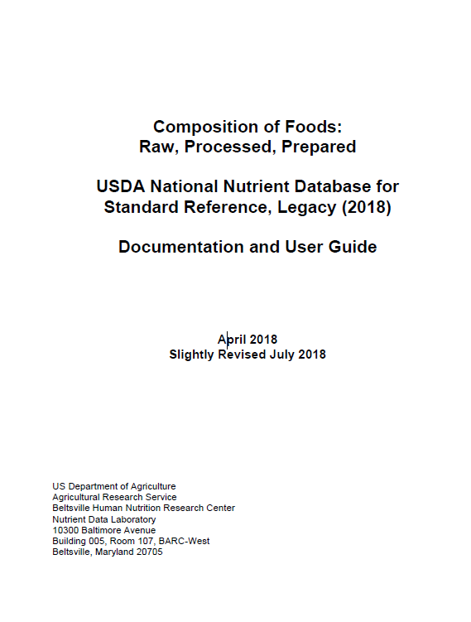
Standard Reference Legacy
Need For Change
>30 years of food composition analysis
65 key nutrients needed for FNDDS
Composited samples from across the United States
Good average values for US exposure
Final release in 2018, no longer updated
Rapid increase in the number and variety of foods in the food supply
New agricultural practices and products
Advancements in science
Evolution of analytical approaches
Branded Foods database launched in 2016
Foundation Foods launched in 2019
Notes:
SR Legacy has been the primary food composition data type in the United States for over 30 years. It is now considered historic food composition data and will not be updated. The nutrient data was derived from analytical methods, imputations, calculations, and published literature.
The data were composite samples from across the United States and reflected good average values. The goal of the SR Legacy was to generate a reliable mean for up to 150 nutrients in highly consumed foods
However, there was a need for change and modernization due to the rapid increase in the number and variety of foods in the food supply. FoodData Central was launched in 2019 and integrated 5 data types into one data system.
Sr Legacy data is still available to users on FoodData Central in addition to the latest data type, Foundation Foods.

Slide 5
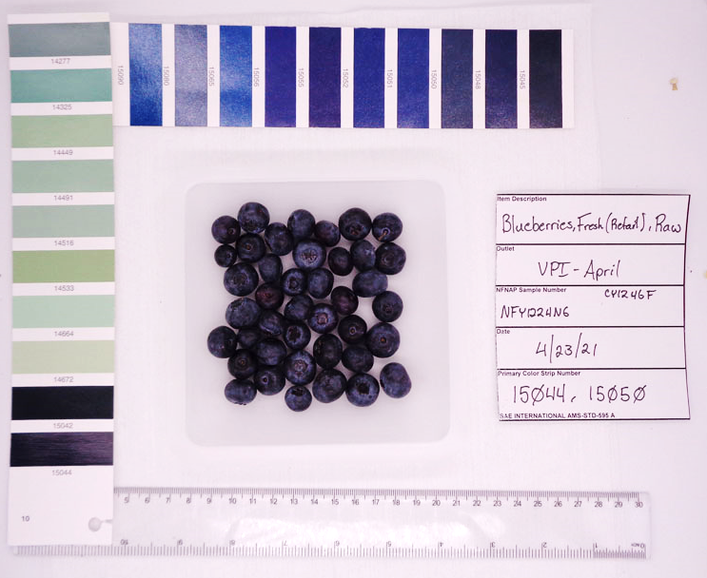
Foundation Foods
Individual food samples that are snapshots in time
Metadata provide on each individual sample
Single commodity/commodity-derived minimally processed foods
Analytical values for components including nutrients
Data includes mean value and give a minimum and maximum values
Notes:
Foundation Foods is a new food composition data type in FoodData Central. Foundation Foods are individual food samples that have analytical nutrient profiles with metadata available on each sample.
The foods analyzed are single commodity or commodity-derived minimally processed foods, such as apples, bananas, carrots, almonds, grains, applesauce, flour, oil, egg, milk, blueberries, yogurt, cheese, seafood and meats.

Slide 6
Problem Statement
Resources for analytical sampling continue to decline and staffing is becoming increasingly limited, FDC is establishing new ways to incorporate data.
It is not feasible to analyze a complete set of nutrients for a single food when the cost of analysis can exceed $50,000.
Gathering insight into how comparable foods have changed over time will provide a better idea as to which components should continue to be analyzed and which ones remain constant and not necessarily analyzed each time a food is updated.
Notes:
Resources for analytical sampling continue to decline and staffing is becoming increasingly limited, FDC is establishing new ways to incorporate data.
It is not feasible to analyze a complete set of nutrients for a single food when the cost of analysis can exceed $50,000.
Gathering insight into how comparable foods have changed over time will provide a better idea as to which components should continue to be analyzed and which ones remain constant and not necessarily analyzed each time a food is updated.

Slide 7
Standard Reference vs. Foundation Food Dataset
Comparing equivalent foods from the SR Legacy data set to the newer Foundation Foods data set
The link between the two datasets is the same ndb number. The dataset with have a column for SR_NDB and FF_NDB which is a number that uniquely identifies a food. The NDB should be the same for FF and SR.
Example: NDB number 16158 identifies the food ‘Hummus, commercially prepared’.
The first digit in a four-digit ndb number or the first 2 digits in a five-digit ndb-number correspond to the food category id
Example: NDB number 11056 has the food category id 11 (vegetables)
NDB number 9040 has the food category id 9 (fruits)
There is a separate table that identifies the food category id to the food category description.
Notes:
A big part of the challenge is to compare equalivent foods from the Standard Reference data set to the Foundation Food data set.
The link between the two datasets is the same ndb number. The dataset with have a column for SR_NDB and FF_NDB which is a number that uniquely identifies a food. The NDB should be the same for FF and SR.
Example: NDB number 16158 identifies the food ‘Hummus, commercially prepared’.
The first digit in a four-digit ndb number or the first 2 digits in a five-digit ndb-number correspond to the food category id
Example: NDB number 11056 has the food category id 11 (vegetables)
NDB number 9040 has the food category id 9 (fruits)
There is a separate table that identifies the food category id to the food category description.

Slide 8
Standard Reference vs. Foundation Food Dataset
Comparing equivalent foods from the SR Legacy data set to the newer Foundation Foods data set
‘Nutrient_id’ is a unique identifier for a nutrient.
There is a separate table that identifies the nutrient id to the nutrient description.
Example: Nutrient_id 1051 corresponds to ‘water’
‘Rank’ Is an alternate way of ordering nutrients instead of listing them alphabetically. Ordering by rank will group similar nutrients (proximates, vitamins, minerals).
Each food will have several nutrients and a corresponding unit of measure (example: iron is shown in mg).
Each nutrient will have data from SR and Foundation Foods
Notes:
‘Nutrient_id’ is a unique identifier for a nutrient.
There is a separate table that identifies the nutrient id to the nutrient description.
Example: Nutrient_id 1051 corresponds to ‘water’
‘Rank’ Is an alternate way of ordering nutrients instead of listing them alphabetically. Ordering by rank will group similar nutrients (proximates, vitamins, minerals).
Each food will have several nutrients and a corresponding unit of measure (example: iron is shown in mg).
Each nutrient will have data from SR and Foundation Foods

Slide 9
Standard Reference vs. Foundation Food Dataset
SR Dataset
Mean
Minimum value
Maximum value
Standard error
Number of data points (n)
*Note that min, max, and standard error values are not available in some of the SR dataset.
Foundation Foods Dataset
Mean
Minimum value
Maximum value
Median
Number of data points (n)
Notes:
SR Dataset
Mean
Minimum value
Maximum value
Standard error
Number of data points (n)
*Note that min, max, and standard error values are not available in some of the SR dataset.
Foundation Foods Dataset
Mean
Minimum value
Maximum value
Median
Number of data points (n)

Slide 10
Standard Reference vs. Foundation Food Dataset
All nutrient values are based on 100g.
Some nutrients are calculated therefore you will only see a mean value and no other statistics associated with that value
Examples of Calculated Nutrients:
Energy
Carbohydrate by difference
Fatty acids
Total saturated fat
Total monounsaturated fat
Total polyunsaturated fat
Notes:
All nutrient values are based on 100g.
Some nutrients are calculated therefore you will only see a mean value and no other statistics associated with that value
Examples of Calculated Nutrients:
Energy
Carbohydrate by difference
Fatty acids
Total saturated fat
Total monounsaturated fat
Total polyunsaturated fat

Slide 11
Questions????
Can we use this data to improve our understanding of analytical sampling?
Have the food components changed over time for equivalent foods (ex. whole wheat flour analyzed in 2010 compared to whole wheat flour analyzed in 2020)?
When comparing nutrients from the two datasets, does the mean value for SR Legacy fall between the minimum and maximum values of the Foundation Foods?
Which nutrients fall out of range the most and which fall in range more frequently?
Which food groups have had the biggest change?
Notes:
I have provided a few possible questions to think about but you are more than willing to develop and answer your own questions as you see appropriate.
Some of the questions I generated are…
Can we use this data to improve our understanding of analytical sampling?
Have the food components changed over time for equivalent foods (ex. whole wheat flour analyzed in 2010 compared to whole wheat flour analyzed in 2020)?
When comparing nutrients from the two datasets, does the mean value for SR Legacy fall between the minimum and maximum values of the Foundation Foods?
Which nutrients fall out of range the most and which fall in range more frequently?
Which food groups have had the biggest change?
That is all the information I have and I appreciate your time and analysis as you dig into this dataset! I wish everyone the best. I will be around for the remainder of the day to answer any questions you may have. Thank you!

